Slide 1
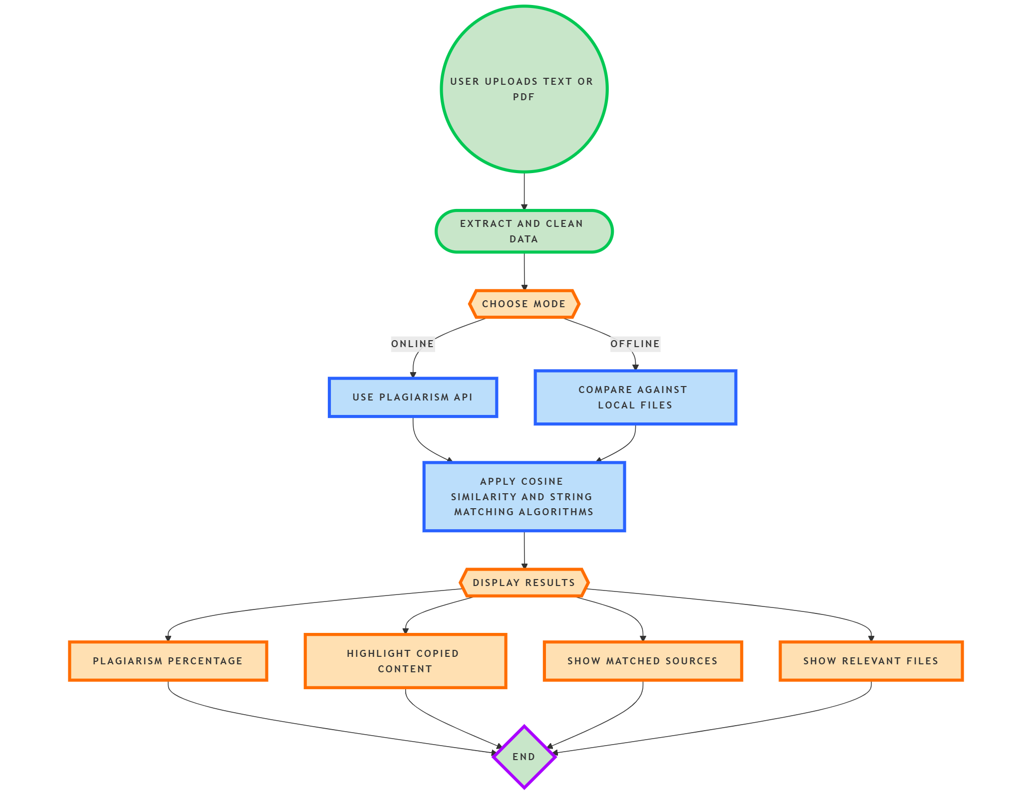
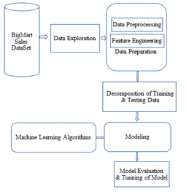
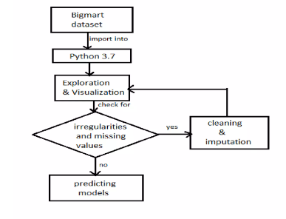
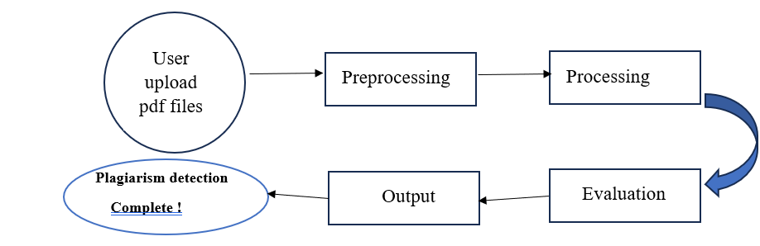
MGM’s College of Engineering, Nanded
Department of Computer Science & Engineering Academic Year 2024-2
“Big mart Sales Prediction System”
Introduction: This Big Mart Sales Prediction System mini-project explores the application of machine learning techniques to predict sales for BigMart, aiming to improve forecasting accuracy and strategic decision-making. We utilize a comprehensive dataset encompassing historical sales, promotional activities, store attributes, and external economic indicators. This mini-project demonstrates that integrating advanced analytical techniques and machine learning into sales forecasting can significantly improve accuracy and provide valuable insights.
Model Architecture:
Methodology:
Spelling Correction Model
Post Processing
Name Of Students: S wapnil Pawar
Arsalan Khan
Quazi Saif
Quazi Qudsiya
Hazari
Name of Guide:
Conclusion: The Big Mart Sales Prediction System successfully demonstrates how machine learning can be used to forecast sales in a retail environment. By analyzing historical sales data and incorporating features such as product visibility, outlet size, location type, and product category, the system provides accurate and actionable sales predictions.
Ms. A. D. Hazari

